Slide 1
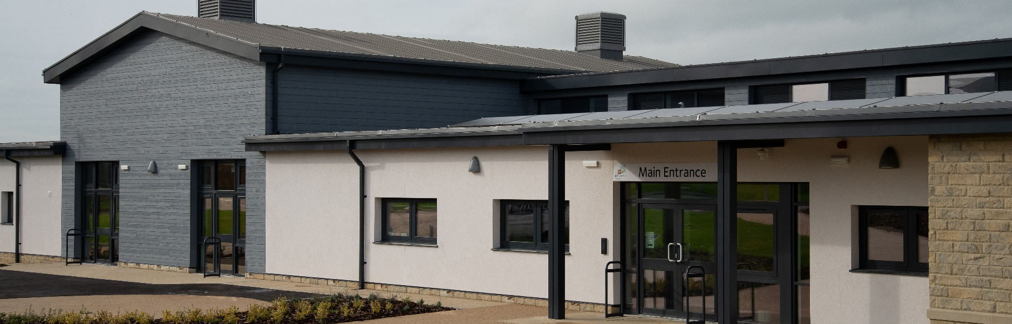
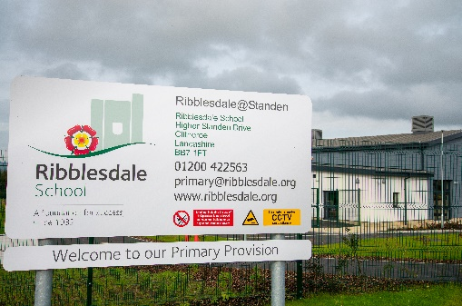
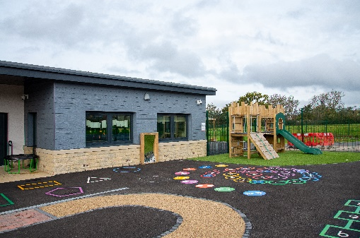

Ribblesdale Primary School
EQUANS UK & Ireland
KEY INFORMATION:
CLIENT: Lancashire County Council
LOCATION: Clitheroe CONSTRUCTION VALUE: £8.95m CONTRACTOR: Equans
START: October 22
FINISH DATE: September 23
SECTOR: Education
FORM OF CONTRACT: JCT Standard Form with Design Portions
DELIVERY TYPE: Modular
PROJECT OVERVIEW:
Equans has completed work on a brand-new, modular construction primary school in Ribblesdale, Clitheroe, on behalf of Lancashire County Council. The work was led by Equans’ Construction and Public Sector team in the North West.
The benefits of modular construction are vast; mainly that it allows for a higher build quality, which is also more energy efficient. Modular construction also means a faster build time as opposed to traditional construction methods with less on-site trades.
The school includes ground source heat pumps, supplying the school with a sustainable source of heat and hot water. Solar PV is also a feature, installed on the roof, generating power for the school.
KEY DELIVERABLES/CHALLENGES
Working within Taylor Wimpey House Site, this required initial meetings to agree H&S protocols then weekly coordination meetings to monitor and update.
Completion of the school ready for the 1st intake of reception children on the 6th September 23.
Ensuring the construction of the modular units meet quality, cost and progress. This was managed by monthly visits to the factory to undertake QA and chair progress and cost meetings.
Installation of 21no ground sourced heating loops combined with GSHP to provide heat and hot water.
The weather in Clitheroe its own microclimate, so managing standing water was a huge part of the logistic plan combined with programming of activities.
Educating College and High School children on Modular construction and trying to inspire the next generation into the construction industry.
SOCIAL VALUE PROMISE:
1no T-Level Industry Placement
8hrs Training/Employment Support
9hrs College/High School Engagement
9hrs Primary School Engagement
96hrs Environmental Volunteering
96hrs Community Volunteering
£2000 Community Donation
1no Foodbank Collection
“Equans is delighted to have completed this low-carbon, modular school on behalf of Lancashire County Council. The education provided here is vital to the local area in the context of the wider regeneration, and we’re delighted to have provided a sustainable building that will allow this for years to come”
Alyson Seddon, Construction Director at Equans
For more information please contact NWCH – Mike Tyler mike.tyler@manchester.gov.uk/ 07885 801 477 or Ian Hall ian.hall@manchester.gov.uk

