Slide 1
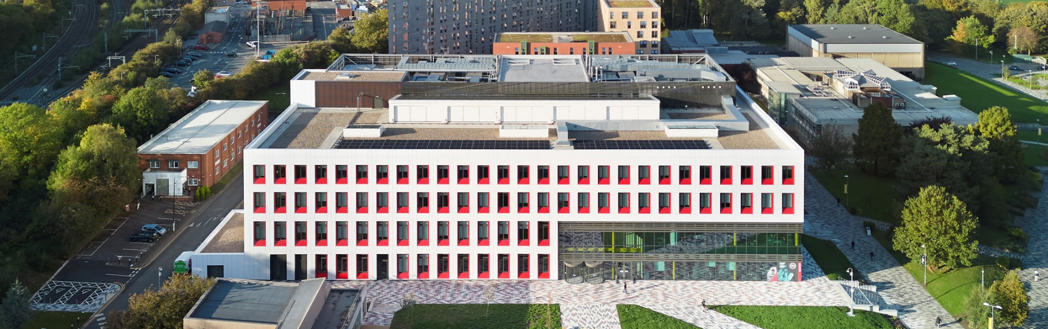
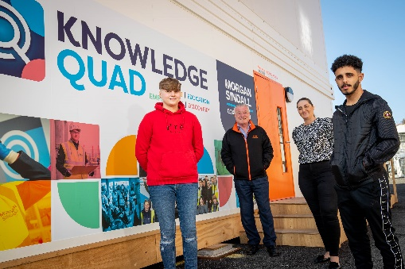


SEE Building
University of Salford Science, Engineering and Environment Building
Main photo to go here
KEY INFORMATION:
CLIENT: University of Salford
LOCATION: Salford
CONSTRUCTION VALUE: £49.5m
CONTRACTOR: Morgan Sindall
START - FINISH DATE: June 20 – July 22
SECTOR: Higher Education
FORM OF CONTRACT: NEC 4 Option A
DELIVERY TYPE: Two Stage
PROJECT OVERVIEW:
The Science, Engineering and Environmental (SEE) Building brings an entire faculty together in one collaborative space. The fully electric-powered facility features specialist equipment such as flight simulators, robotics, automotive, laser laboratories and a wind tunnel.
The SEE Building forms part of the Salford Crescent and University District wider masterplan, and brings together an entire faculty in one space at the University of Salford. It serves as an exemplar model of the University’s commitment to its industry collaboration strategy.
The four-storey, 15,550m2 steel frame building is occupied by the University’s departments of Robotics; Built Environment, Architecture, Civil Engineering, Computer Science; and The Morson Maker Space.
A COLLABORATIVE APPROACH WITH multiple stakeholders
The project was delivered via a two stage procurement route mirroring the collaborative ethos of the project with customer, contractor, design and supply chain partners working in a truly collaborative manor from an early stage. This ensured that the design achieved all of the University’s functional requirements within their budget with all partners working together to solve the project challenges.
Each department brought its own operational and functional requirements as well as new and legacy specialised equipment – notably a supersonic wind tunnel and overhead gantry crane, requiring inclusion of a Strong Floor to the building design.
Several collaborative tools and processes were adopted to address these challenges including:
Early contractor engagement.
Detailed workshops to establish and review stakeholder requirements, continually exploring opportunities to rationalise the design.
Early selection of supply chain including MEP, structures, and envelope to explore innovation.
Digital Construction to assist in coordination of design, optimising adjacencies, and gathering of asset-rich data for detailed digital O&M manuals.
A key outcome of this was developing an inovative low carbon steel frame solution resulting in 504t carbon saved and a fully electric building reflecting the university’s sustainability objectives.
SOCIAL VALUE:
£20m social value as calculated by Social Value Portal
60% Local Spend
10 new jobs created for local people (direct employ)
120 new jobs created for local people - 49% local labour
2 graduate position created (direct employ) / 7 in total with supply chain
16 NEETs employed
622 training weeks
706 apprentice weeks - 52 Apprentices
2,768 hours careers support
24 Build Salford employment course beneficiaries
106 weeks paid work experience
“The SEE Building for our students and staff. It is an outstanding new-build which is underpinned by sustainable, intelligent design. Because the team tailored each level of the building to accommodate different uses, we also have an extremely flexible space that will serve the University for years to come.
We thoroughly embedded the philosophy of partnering and collaboration – many people pay lip service to those words, however our relationship with Morgan Sindall has truly been built upon trust. Collaboration has formed the building and will take place in its labs and shared spaces every day."
Jason Challender, Director of Estates, University of Salford
For more information please contact NWCH – Mike Tyler mike.tyler@manchester.gov.uk/ 07885 801 477 or Ian Hall ian.hall@manchester.gov.uk

