Slide 1
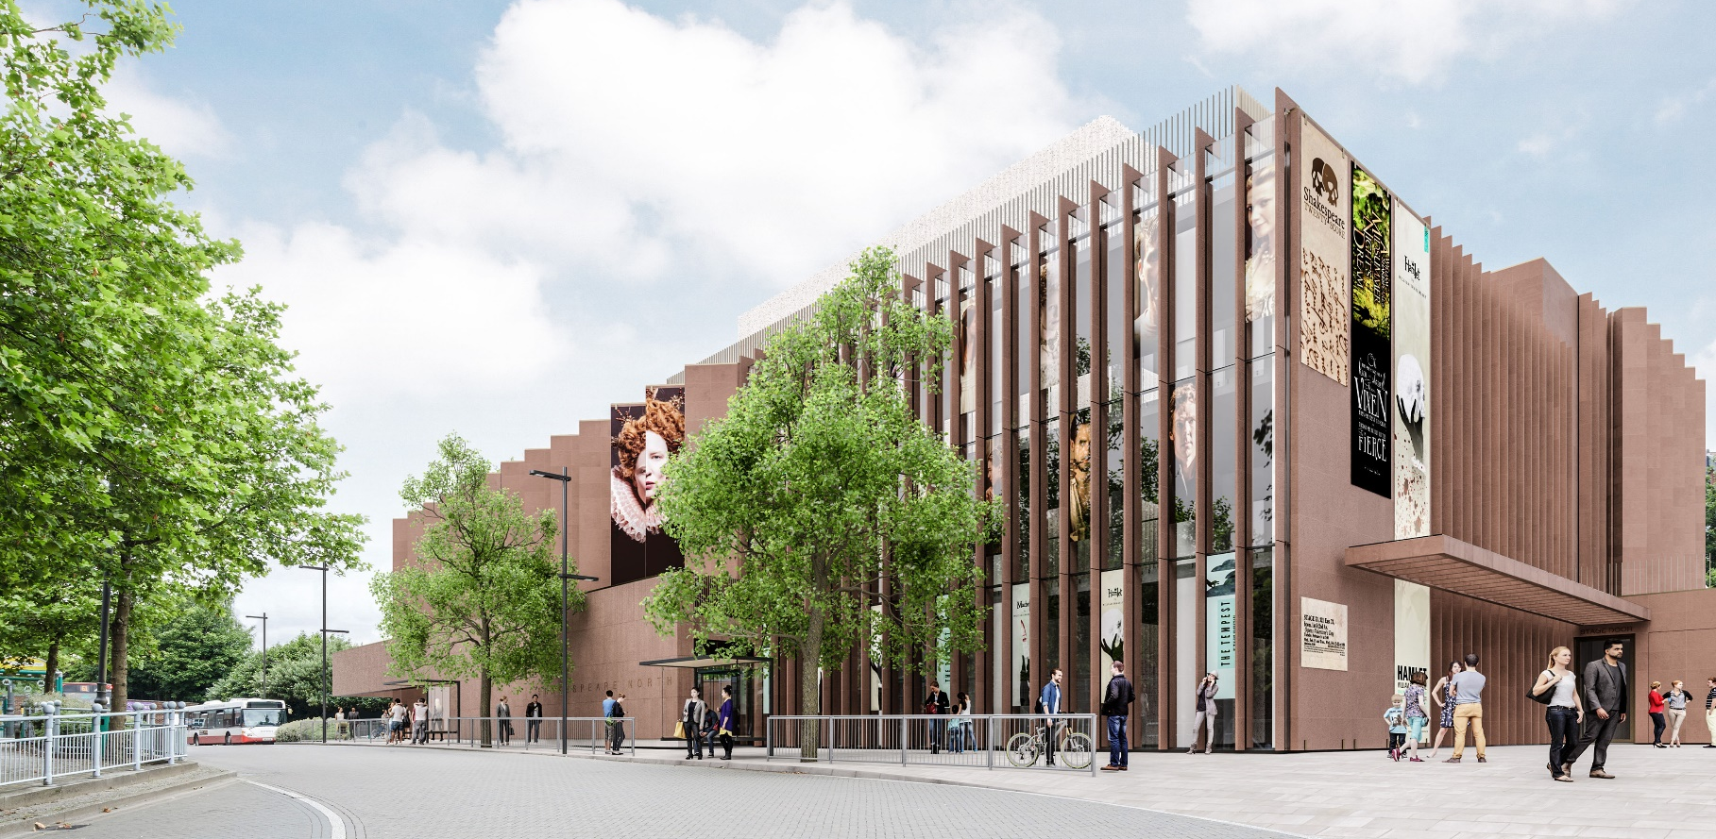
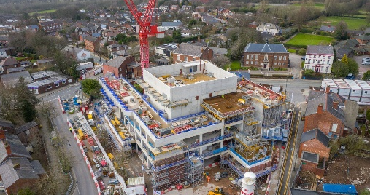
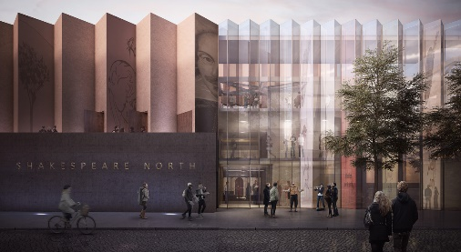

SHAKESPEARE NORTH PLAYHOUSE
A new theatre, cultural and educational attraction
KEY INFORMATION:
CLIENT: Knowsley Council
LOCATION: Prescot
CONSTRUCTION VALUE: £26m CONTRACTOR: Kier
START DATE: Feb 2020
FINISH DATE: May 2022
SECTOR: Arts/ Leisure
FORM OF CONTRACT: JCT
DELIVERY TYPE: Construct only
The Shakespeare North Playhouse is a unique replica theatre within a modern cultural and educational building. A new destination, it will celebrate the connections between Knowsley, Shakespeare and Elizabethan theatre, completing the UK’s Shakespearean triangle – London – Stratford-upon-Avon – Prescot.
The new attraction in the heart of Prescot forms a key part of the regeneration of the town centre and will attract visitors from around the world, broadening horizons and opportunities for local communities.
A UNIQUE BUILDING DESIGN, DRIVING REGENERATION
This contemporary signature building has a striking external façade. The auditorium is a replica of Henry VIII, Cockpit-in-Court, Whitehall, with a copy of the 17th Century Inigo Jones designed ‘Frons Scena’ and will have capacity of 320-470 seats. The Playhouse will form part of a small, exclusive group of international replica theatres including the Globe, London. Key features include:
An outdoor performance garden
Studio (performance and rehearsal)
Educational facilities- for lifelong learning opportunities and an education programme
A high quality digital gallery and integrated visitor experience
Bar/café with attractive external piazza area
Retail and office space
The project is part of a far-reaching regeneration programme to transform the historic town and affect significant, positive changes within the region including new high quality jobs, strong growth in the local economy and much increased footfall in Prescot town centre.
AWARD WINNING
Shakespeare North recently won the Sustainability Award at the North West Regional Construction Awards for utilising carbon reduction technology. Innovative flywheel technology was used by Kier, in partnership with supply chain partner, Sunbelt Rentals, to power the crane on site, with fuel consumption reduced by 40%, resulting in 40% less carbon being produced. As well as carbon savings, this provided social value benefits to the community, including reduced air pollution and less traffic movements and congestion.
SOCIAL VALUE PROMISE:
11 Apprenticeships
7 jobs created/ employment support
7 work experience placements
56 training weeks
9 education & curriculum/ construction industry careers events
8 community engagement activities
1 meet the buyer event
“The Shakespeare North Playhouse is a transformational development for Prescot, Knowsley and the wider Liverpool City Region. It is forecast to attract more than 140,000 new visitors to the area, increase spending in the local economy, create new jobs and opportunities for the local supply chain.”
COUNCILLOR GRAHAM MORGAN- LEADER OF KNOWSLEY COUNCIL
For more information please contact the NWCH Management Team: nwch@nwconstructionhub.org | nwconstructionhub.org

