Slide 1
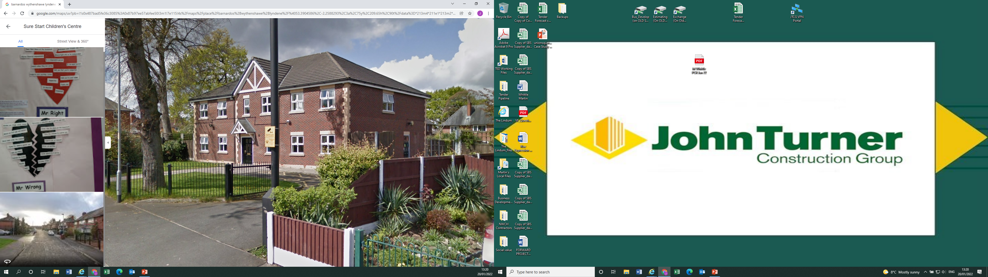
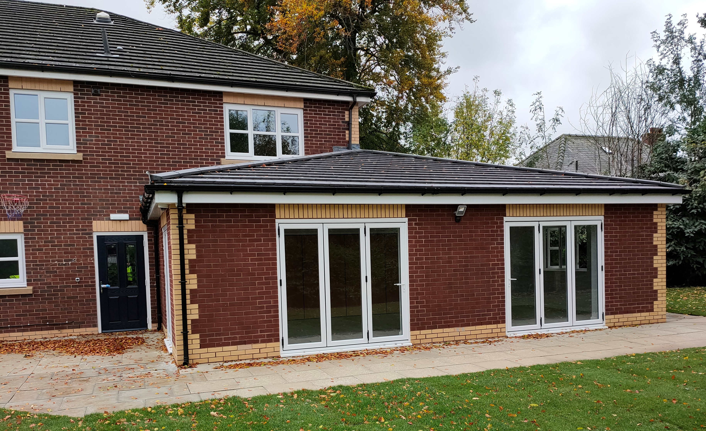
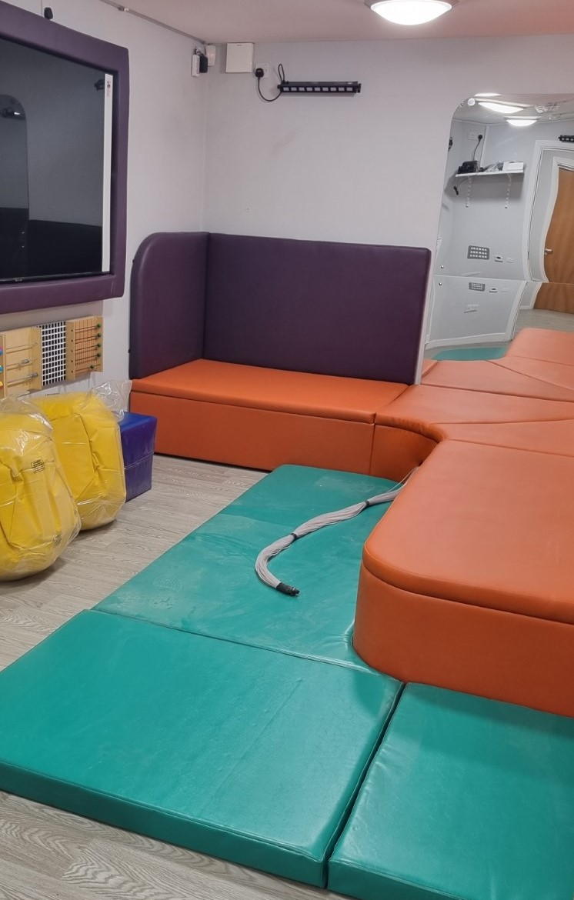

Lyndene Children’s Home
CLIENT:
Manchester City Council
LOCATION:
Wythenshawe
CONSTRUCTION VALUE:
£760,000
CONTRACTOR:
John Turner Construction Group
START - FINISH DATE:
May 2021-November 2021
SECTOR:
Civic
FORM OF CONTRACT:
Public Sector Partnering Contract
DELIVERY TYPE:
Extension and re-modelling
This project included the refurbishment and conversion of a former residential children’s home into a facility that now offers residential short breaks and edge of care support to children and young people with autism and learning difficulties, within a bespoke safe environment.
The remodelling included the construction of a new single storey extension along with major internal adaptation works. A new sensory suite, sensory bathroom, calm room, kitchen and laundry room have been created along with new en-suite bedrooms, a new passenger lift, office, storage and staff space.
All new building services have been installed including energy efficient lighting and underfloor heating, by our in-house electrical division. A major element was the installation of a new ground source heat pump, to deliver sustainable heating and hot water.
External improvements included the replacement of the existing windows and doors along with the construction of a new outside play area.
The project was delivered in a 25 week period during the COVID-19 pandemic.
We ensured that opportunities for employment were advertised in the local area and one individual working on site via a labour agency was subsequently offered permanent employment.
Recognising the importance of professional development we delivered a total of 5 weeks training on site, to enable 3 apprentices to work towards the completion of their NVQ level 3 qualifications. One apprentice has since completed his end point assessment and is now employed as a fully-qualified site joiner.
We recruited a graduate from the local area as an Assistant Quantity Surveyor to work on the project and have since made his employment permanent.
Employees on site were provided with free training in health and safety, environmental awareness and equality & diversity. The Site Manager completed Mental Health training and key employees completed Banksman and PASMA training.
All employees on the project had access to a Mental Health First Aider and our Employee Assistance Programme. Tool-box talks were delivered on Wellbeing at Work and literature regarding support groups, including Andy’s Man Club, were made available to all workers on site.
SOCIAL VALUE OUTCOMES:
2 new employees from local area
27% of employees on project from the local area
10 apprentice weeks delivered
3 apprentices supported to complete their NVQ3
2 employees completed industry certified qualifications
t”I would like to reiterate our thanks to Paul Roberts and the wider John Turner Construction project team for the superb delivery of the Lyndene Children’s Home project. On behalf of our client in Children’s Services, I would like to add their delight in the quality of finish, professionalism of the team and the ‘here to help’ attitude given throughout.
A very successfully delivered project.”
Tony Holland,
Team Leader, Minor Works, Capital Programmes and Procurement,
Manchester City Council
ony.holland@manchester.gov.uk
For more information please contact the NWCH Management Team: nwch@nwconstructionhub.org | nwconstructionhub.org

